Slide 1
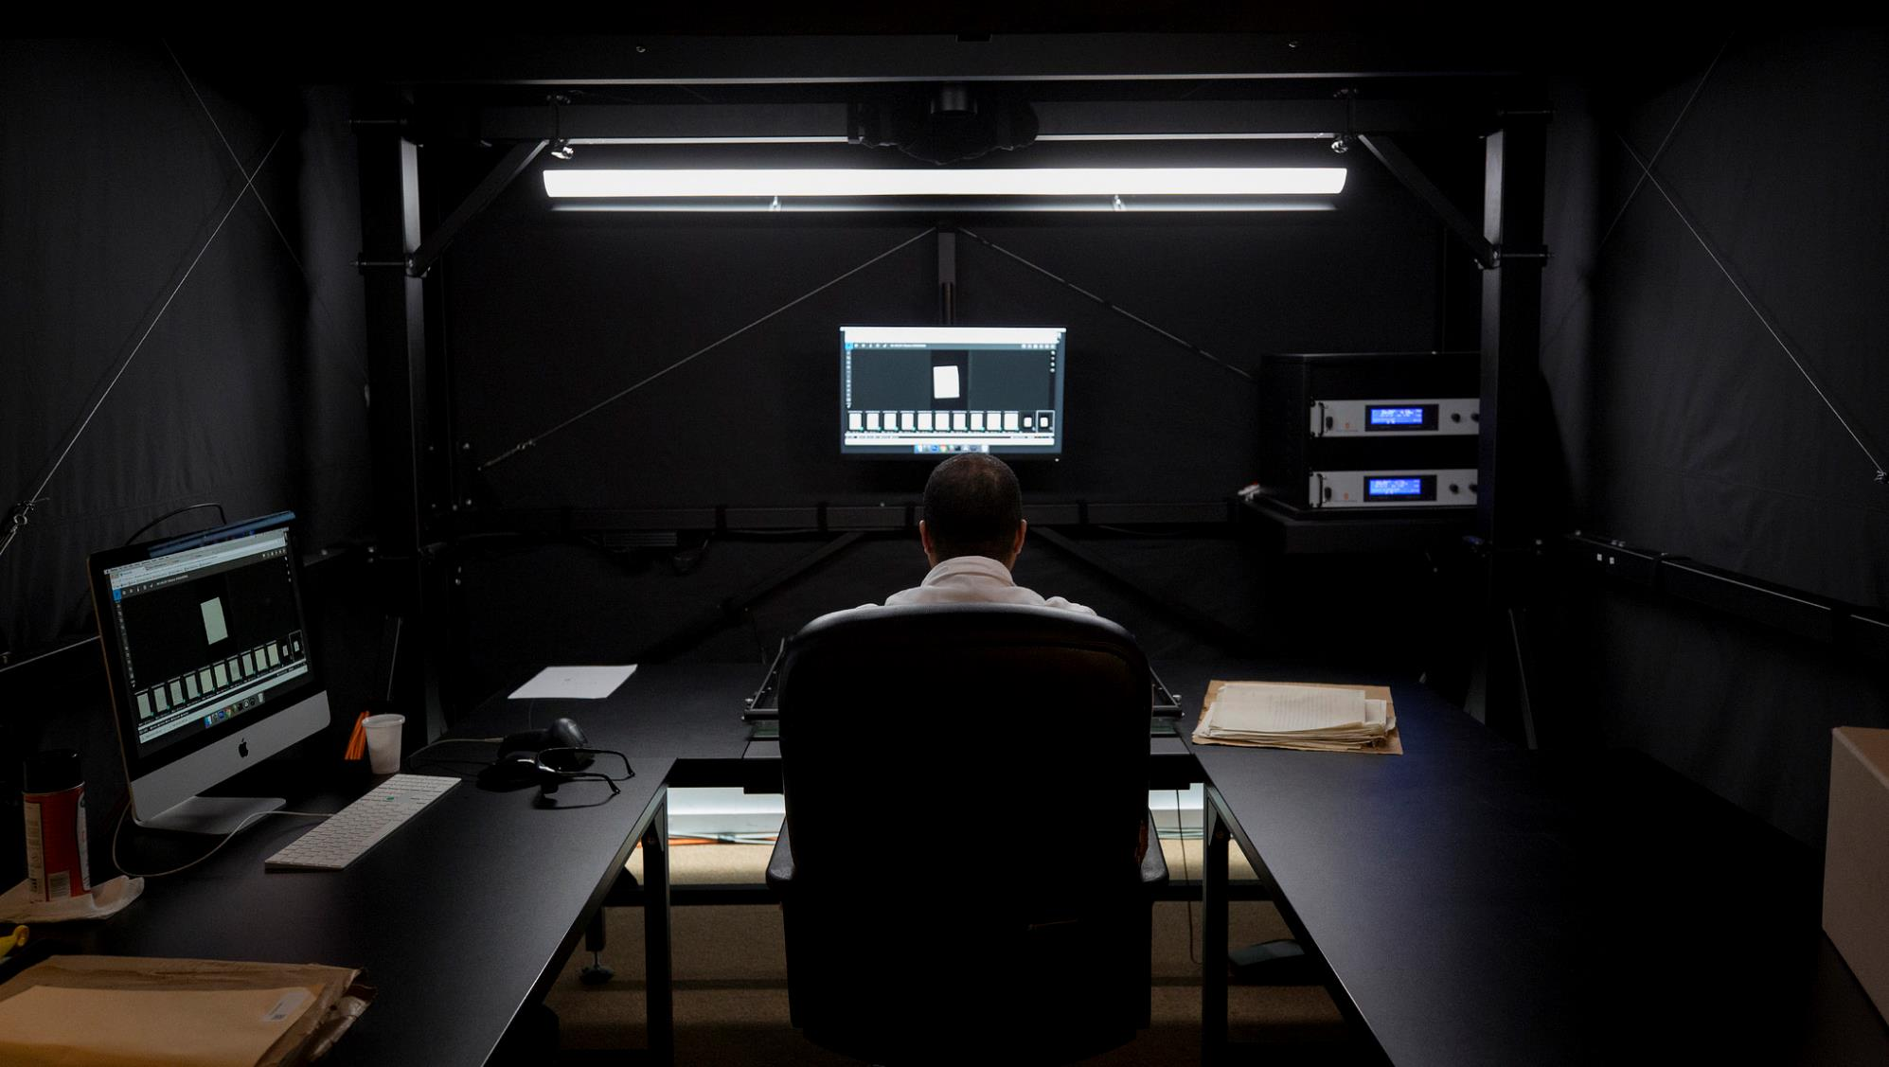
digitizing our shared UNESCO history
project for safeguarding and promoting UNESCO’s own documentary heritage

Slide 2
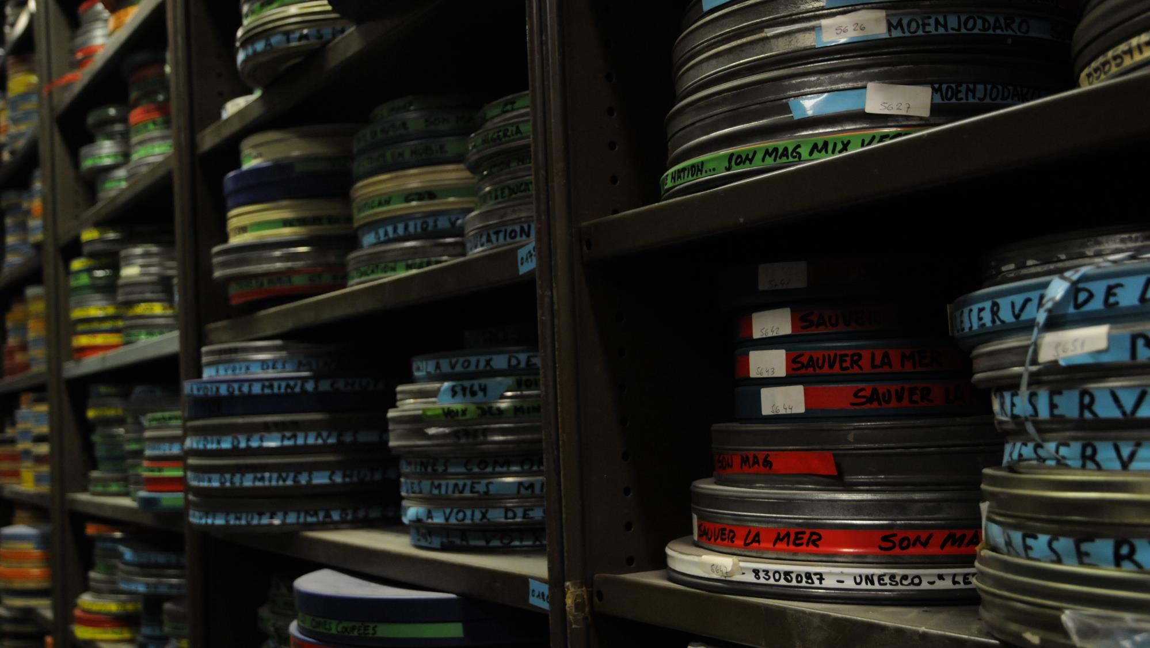
contents*
background
lab
archives and collections
crowdsourcing
visibility
next
* challenges are noted throughout

Slide 3
background
UNESCO’s institutional archives and historical AV collections are a record of UNESCO’s mission to contribute to the building of peace, the eradication of poverty, sustainable development and intercultural dialogue through education, the sciences, culture, communication and information.
They also provide evidence of a history of international cooperation; of individual countries and newly independent states participating in and developing activities related to UNESCO’s domains.
why digitize?

Slide 4
background
After decades of physical handling, frequently consulted paper records are showing signs of wear and tear.
Historical AV collections, transferred to Archives from the Div. of Public Information only in 2015, are inaccessible, mostly unknown and at serious risk of being lost forever.
Digital surrogates will contribute to the continuity of and access to the content, as well as to the preservation of the original materials by reducing the risk of damage incurred through handling, extending their longevity and historical value.
why digitize?

Slide 5
background
In 2018, the UNESCO Archives launched a digitization effort to safeguard and highlight UNESCO's own documentary heritage.
This unprecedented (for UNESCO) two-year project is an important step in making the unique archives and its historical audiovisual collections more accessible and more widely known to researchers and the public at large.
Among the records being digitized are the archives of the International Institute of Intellectual Cooperation (IICI), one of UNESCO's predecessors. The IICI archives were inscribed on the UNESCO Memory of the World Register in 2017.
why digitize?

Slide 6
background
Generous support for this project has been provided by the Government of Japan.
sponsor

Slide 7
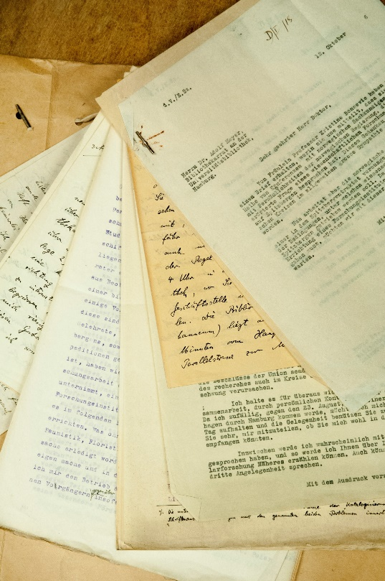
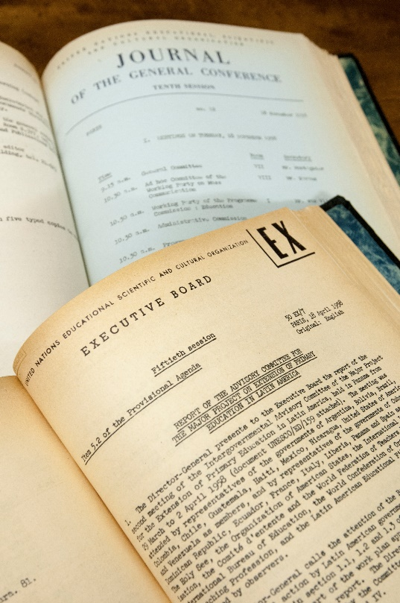
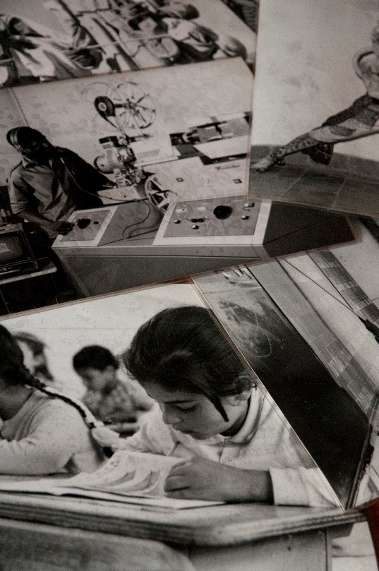
background
672,118 pages of archival files of the International Institute of Intellectual Cooperation (IICI)
560,000 pages of bound General Conference and Executive Board documents from the first 20 years
scope
5,000 photographic prints

Slide 8
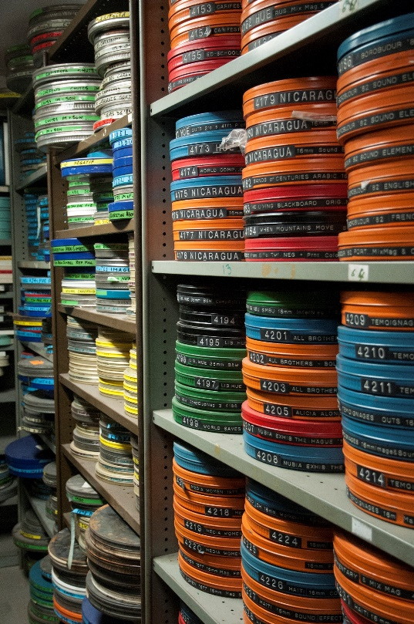
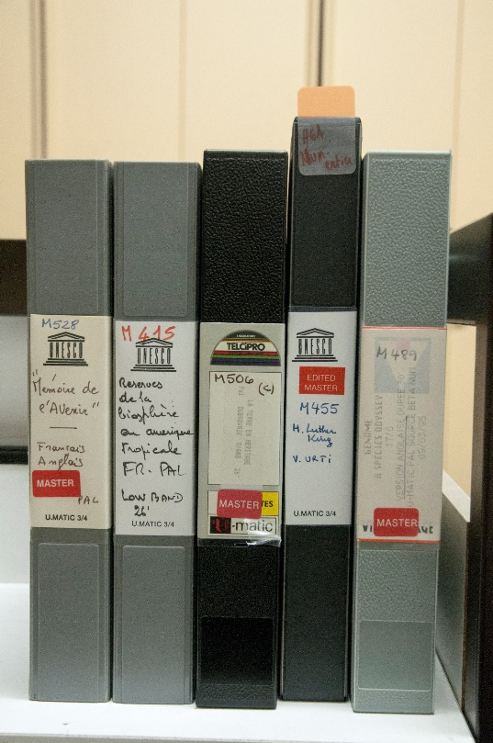
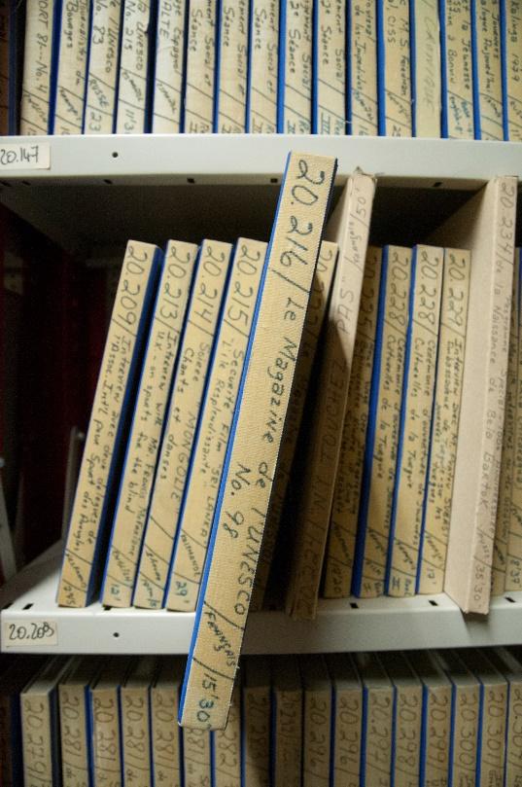
background
108 16mm films (≈45 hours)
98 Umatic videos (≈35 hours)
scope
17,901 ¼ inch magnetic tape recordings (≈7,000 hours)

Slide 9
background
Chief Information Officer (Chair)
Chief Archivist
Director, Division of Public Information
Programme Specialist, Memory of the World
Vendor Representative
steering committee

Slide 10
background
Adam Cowling Project Manager RM Specialist
Giovanna Hendel Project Coordinator
team
Eng Sengsavang Reference Archivist
Maëva Nguyen Project Assistant
Cataloguing Librarian
5 Service Contractors
2 Interns
6 Operators (Vendor)

Slide 11
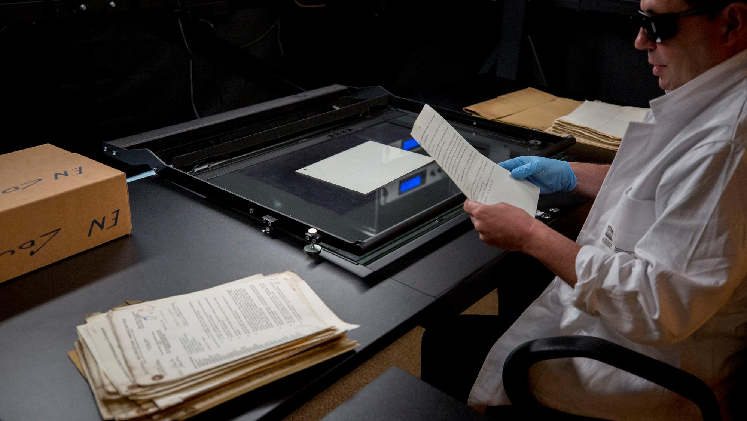
lab

Slide 12
lab
What is the Archives’ Digitization Laboratory (the “Lab”)?
The Lab is a space of ideas and a crossroads where unique archival heritage meets the best of current digitization technologies.
Together with our Vendor, we installed advanced digitization equipment, as well as storage, processing and quality control workspaces where team members are undertaking a 2 year project led by the UNESCO Archives.
Why do digitization on-premise?
First, avoid, as much as practically possible, the transport of unique, one-of-a-kind archives off-site
Second, make the project as visible as possible for UNESCO staff, UNESCO’s Member States and public visitors to the Headquarters complex
Avoid “out of sight, out of mind”
Demonstrate and communicate on an on-going basis the value, complexity and sheer scale of such an undertaking
info

Slide 13
lab
Location options are limited when space is at a premium
Not as central/visible as desired, but “fishbowl” a plus
No elevator to this level
Partition removal (HQD always said “No”)
Electricity and network cabling had to be redone; network switch installed
No line to data centre initially – had to push for this; server room set-up; “naturally” cooled
Significant increase in bandwidth; requires monthly investment in dedicated line; issues with outages
Changes to schedule for cleaning, security, electricity/lighting downtimes
challenges

Slide 14
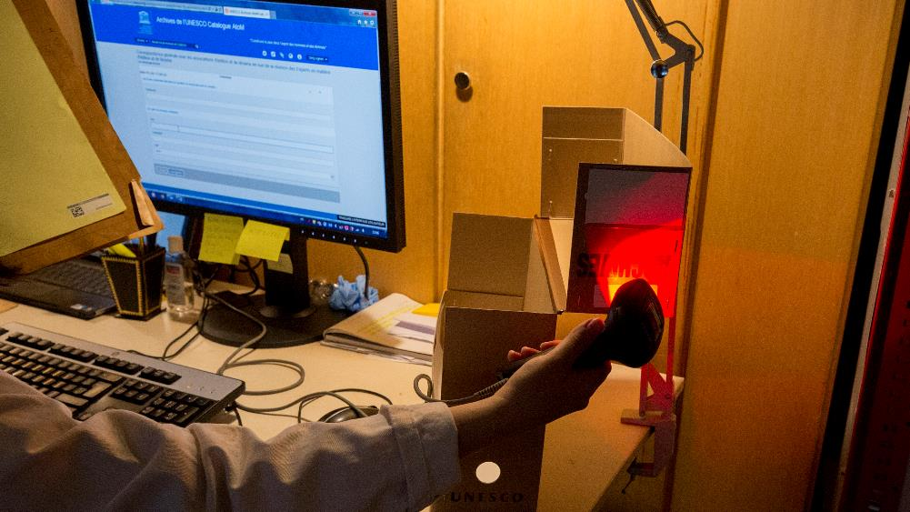
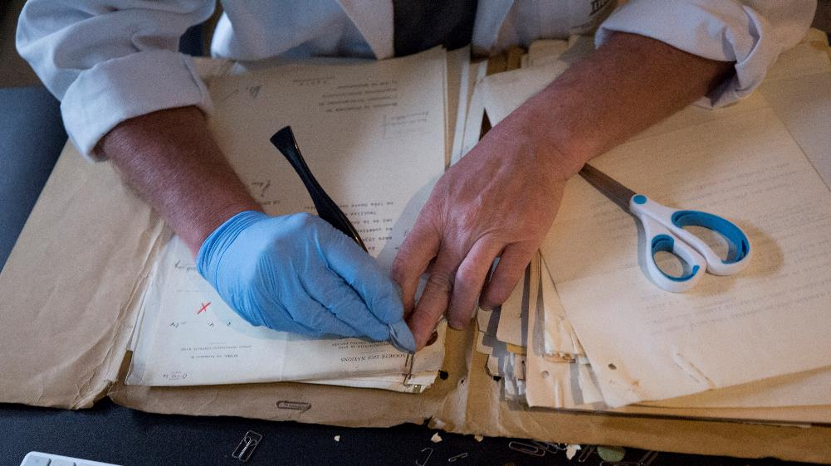
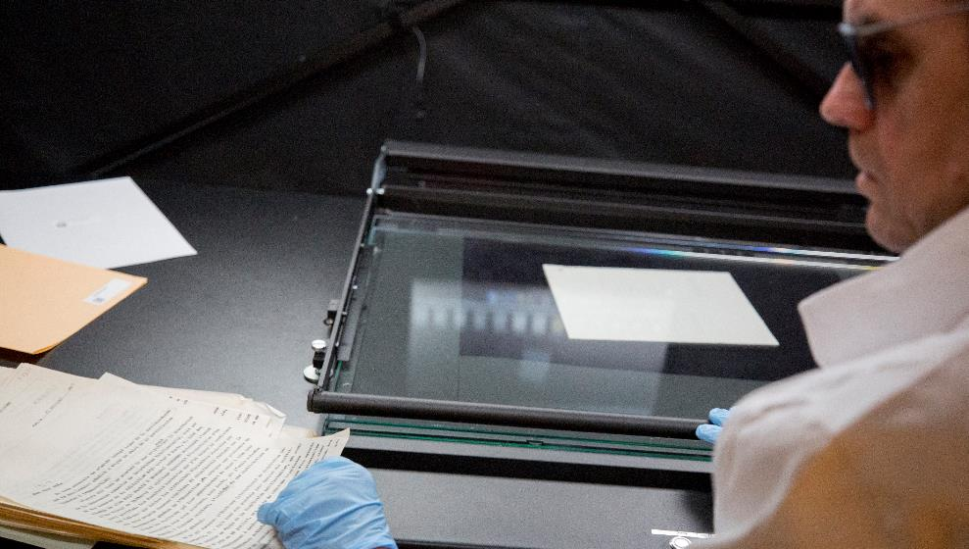
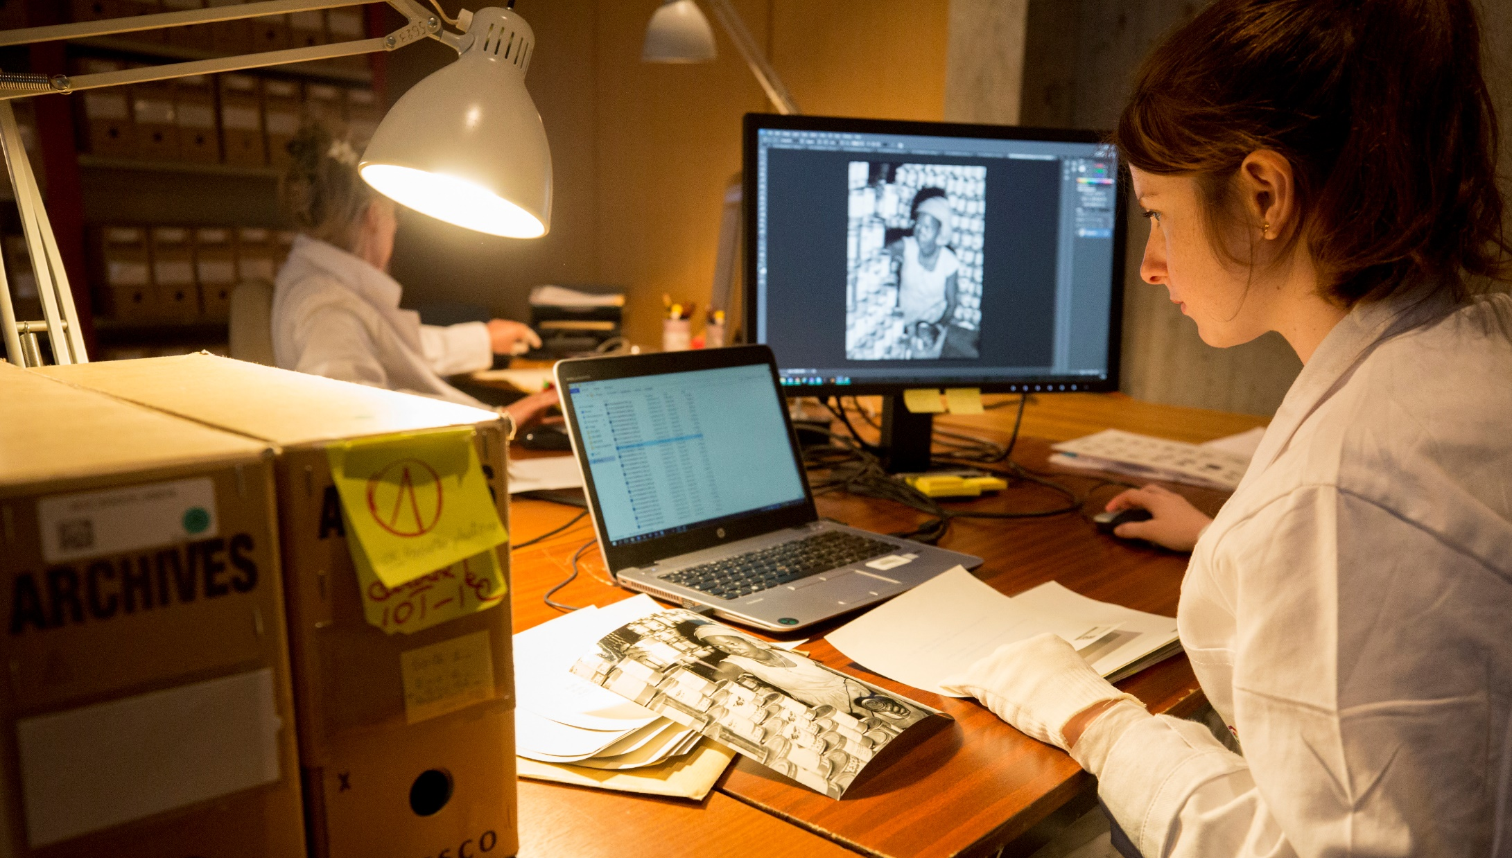

Slide 15
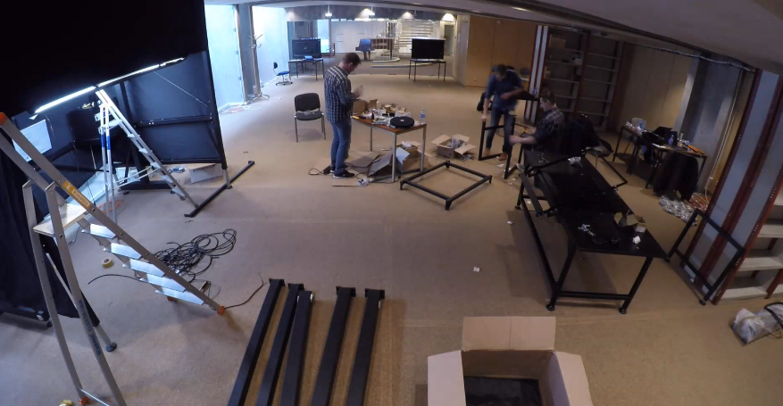
lab
The Lab is scheduled to operate until the end of 2019 digitizing the collections currently in scope.
Notes:
Why do digitization on-premise?
We decided to install a Lab on-premise at UNESCO for two reasons:
First, we wanted to avoid, as much as practically possible, the transport of unique, one-of-a-kind archives off-site, as this would substantially increase of the risk of damage or loss; and,
Second, we wanted the project to be as visible as possible for UNESCO staff, UNESCO’s Member States and public visitors to the Headquarters complex. We know from experience that projects such as this one, if out of sight, are often out of mind. So for the project team, it was important to be able to demonstrate and communicate on an on-going basis the value, complexity and sheer scale of such an ambitious undertaking.
What’s special about the Lab?
Well, in addition to the great team members and the advanced equipment, one of the most innovative aspects of the Lab is the “fish bowl” design. One whole wall of the Lab is glass, so visitors and passers-by can see what’s going in the Lab without having to worry about disturbing the team working inside. The “fish bowl” is of course an important aspect of project communication.

Slide 16
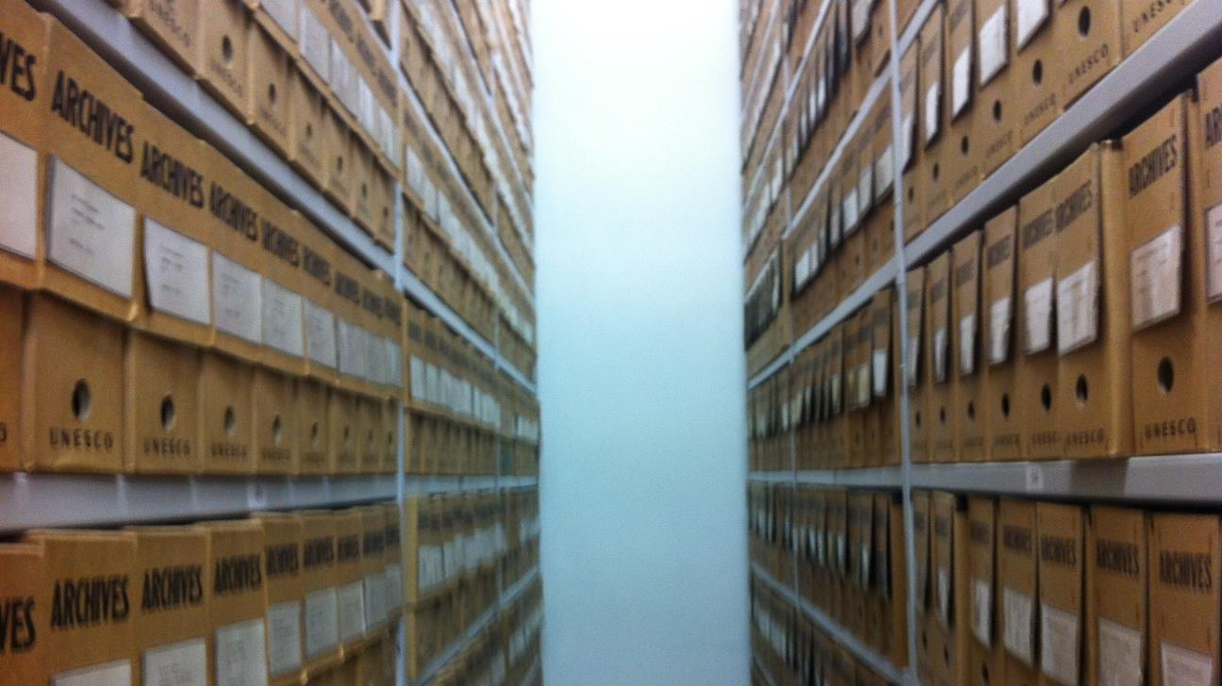
archives
IICI archives

Slide 17
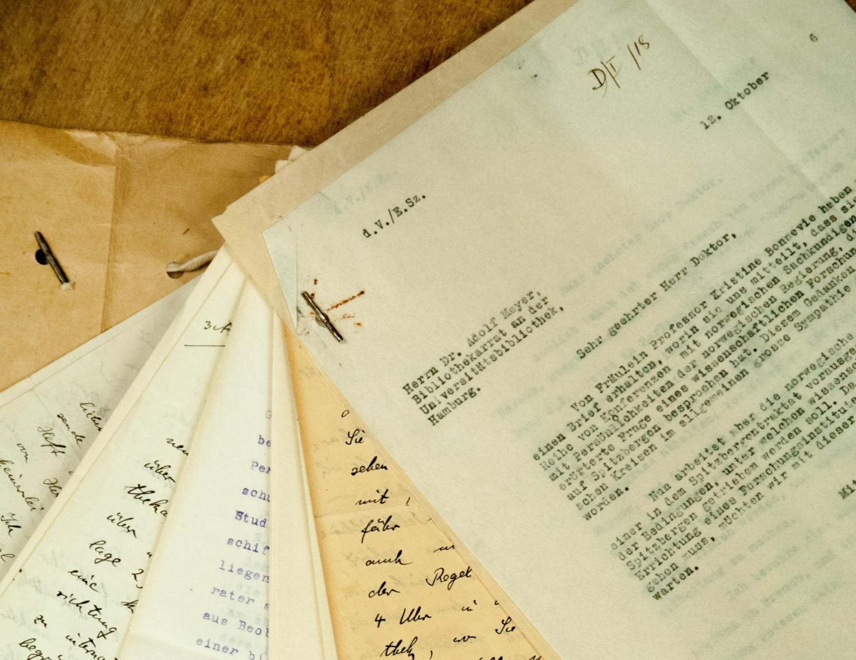
IICI archives
Volume:
672,118 loose-leaf pages (661 boxes; 4,669 files)
Tech. specs:
Documents (unbound): archival files Master: JPEG2000 Access: PDF/A Resolution: 400ppi Bit Depth: 16 Colour

Slide 18
IICI archives
About: A precursor of UNESCO, the Institute’s archives constitute a precious source of knowledge on international cooperation by major intellectual figures between the two world wars. Inscribed on MOW in 2017. Complement LoN archives at UNOG.
Challenges:
Description was not comprehensive
More non-conformity than estimated
Oversize; stitching
Fewer total pages than estimated (13%)
Escalation resulted in QC issues
Conservation: All paper clips, staples, etc. removed. Minor tape fixes. Folders and boxes changed.
Remaining: IICI publications. Note: The IICI archives represent about 2% of the total paper archives held by UNESCO Archives.

Slide 19
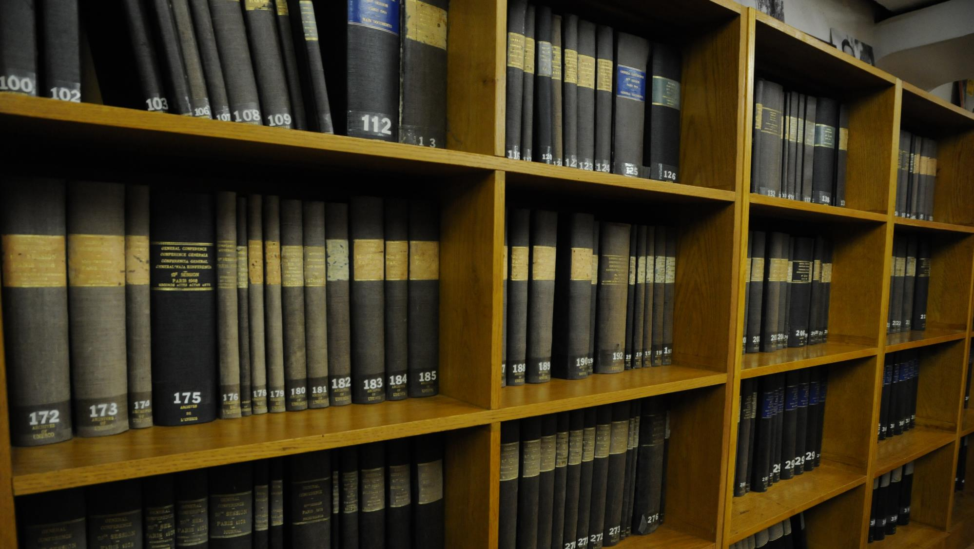
collections
governing documents

Slide 20
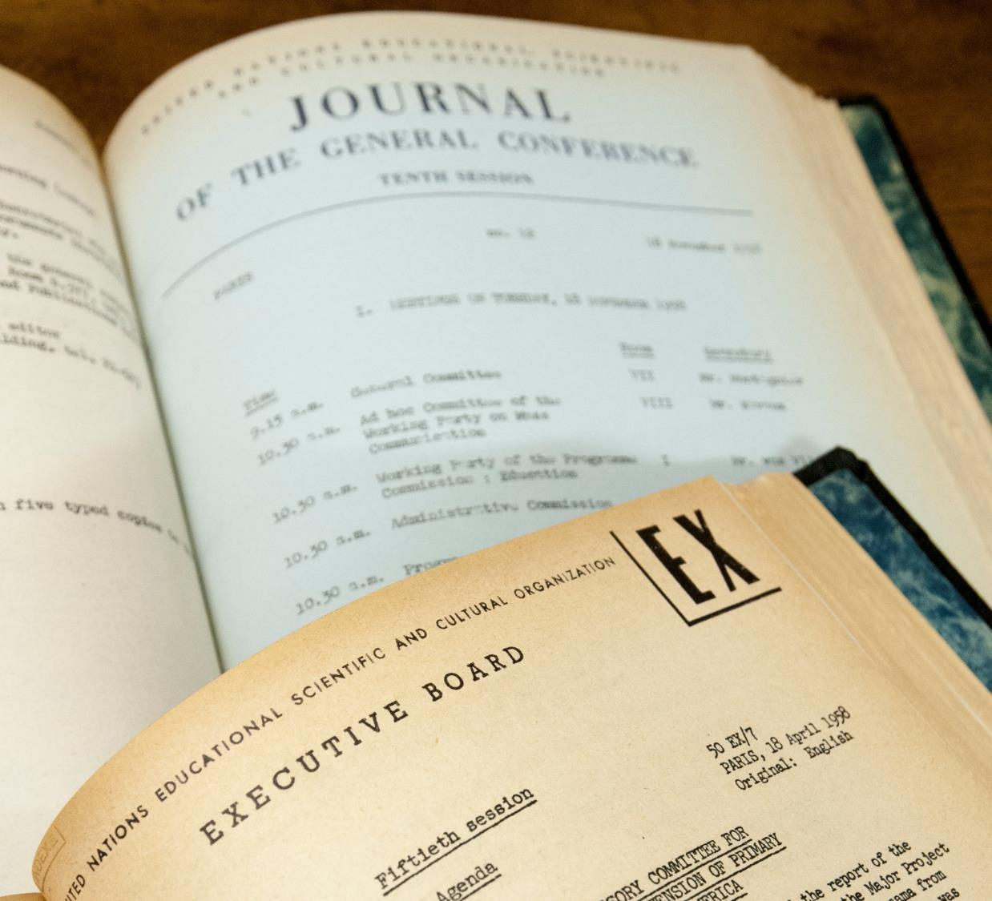
governing documents
Volume:
560,000 pages (898 volumes; 68,000 documents)
Tech. specs:
Bound volumes: general collections Master: JPEG2000 Access: PDF/A Resolution: 300ppi Bit Depth: 8 Colour

Slide 21
governing documents
About: UNESCO Governing bodies documents from the late 1940s and 1950s that currently exist only on paper (and poor quality microfiche).
Challenges:
Bibliographic records not complete; significant effort
Locating the complete collection
Barcoding individual documents
Conservation: GC/EXB document collection not unique. Minor tape fixes.
Remaining: Need to complete other language versions, and fill holes after 1966.

Slide 22
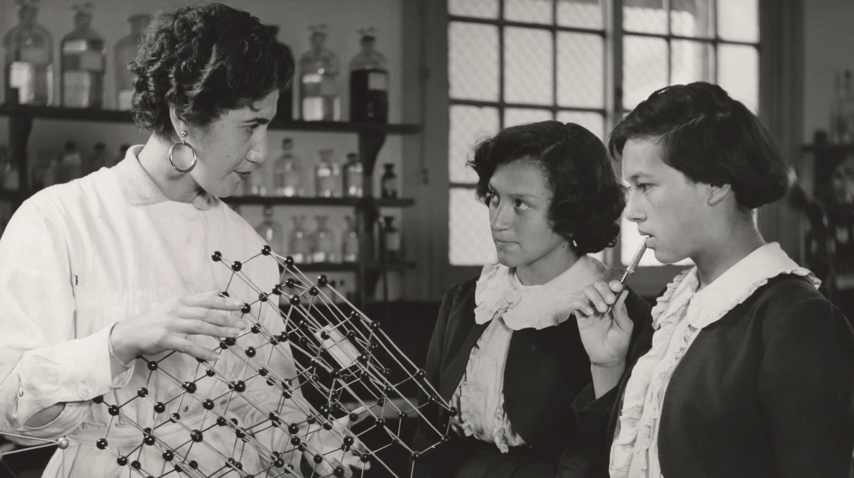
collections
photographs

Slide 23
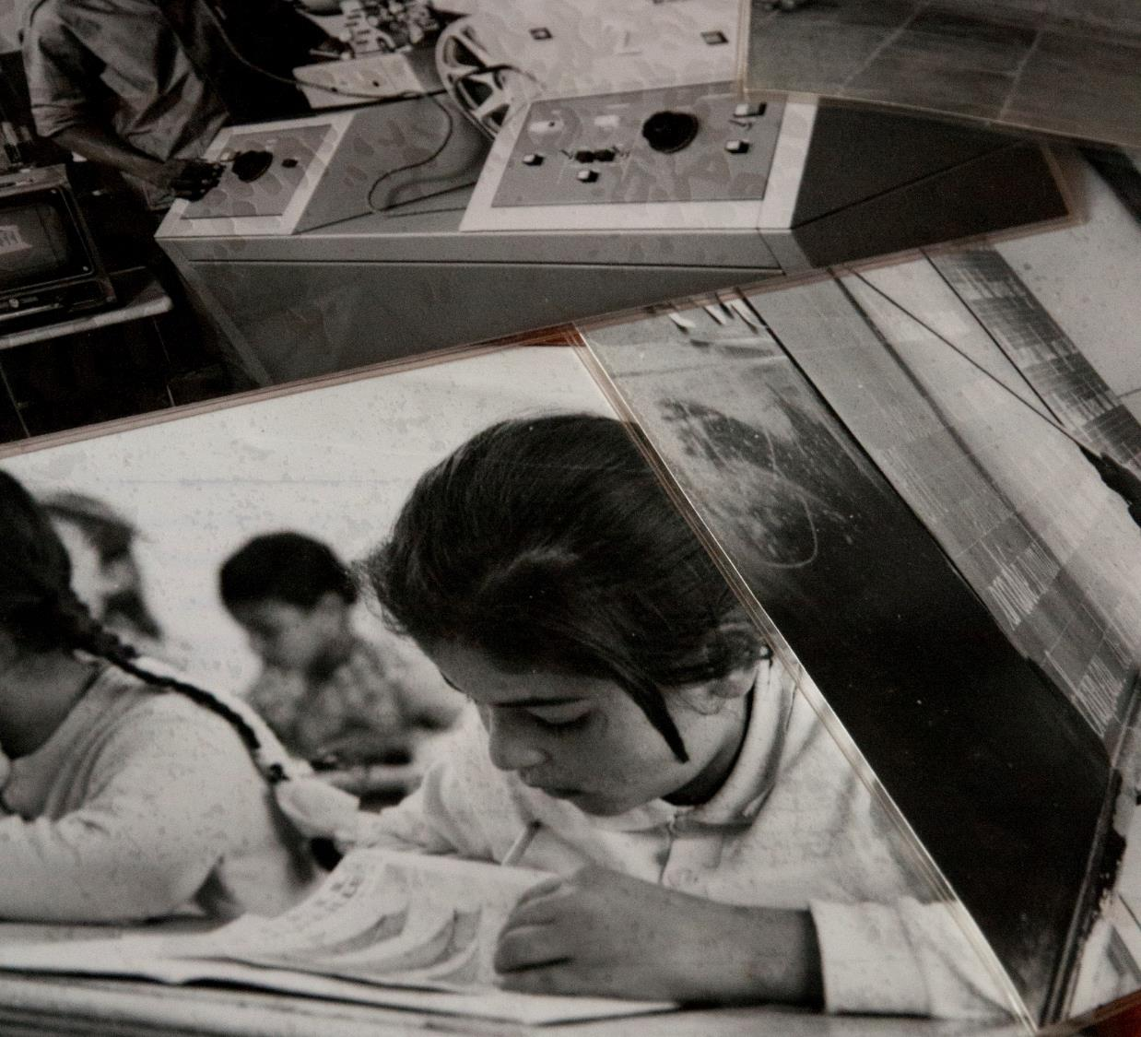
photographs
Volume:
5,000 prints recto/verso (10,000 images)
Tech. specs:
Prints/Photographs Master: JPEG2000 Access: JPEG2000 Resolution: 600ppi Bit Depth: 16

Slide 24
photographs
About: Photos taken my UNESCO staff and contracted photographers of UNESCO’s activities since 1945. Exceptional photos documenting the Campaigns to Save Venice and the Monuments of Nubia, and other themes like fundamental education, youth, journalism, space exploration, oceanography, and many others.
Challenges: Inherited collection.
Selection took 3 months
Removal of sticky plastic sleeves
Stored in obsolete Kardex machine. Plan to repair.
Paper-based inventories and verso captions
Conservation: New sleeves. Unique IDs.
Remaining: ≈170,000 negatives, slides and prints (97%)

Slide 25
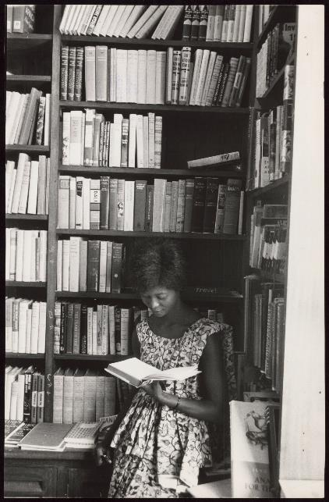
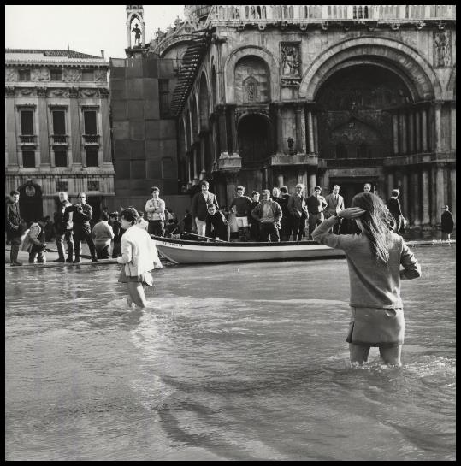
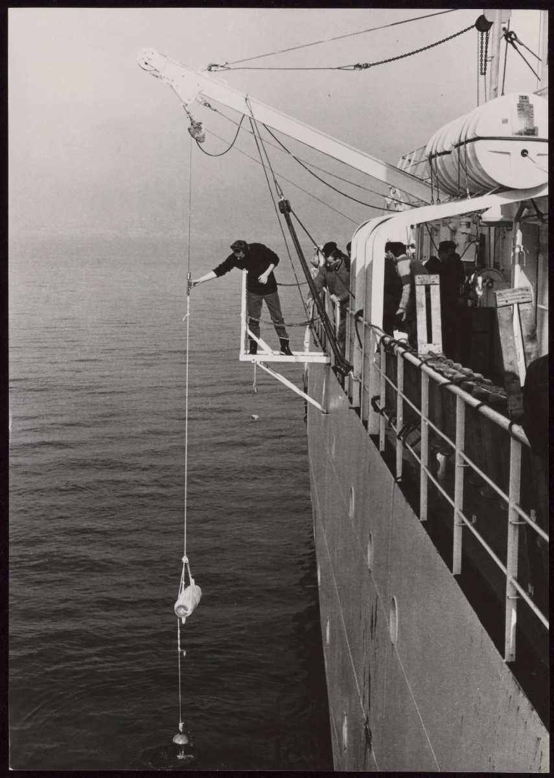
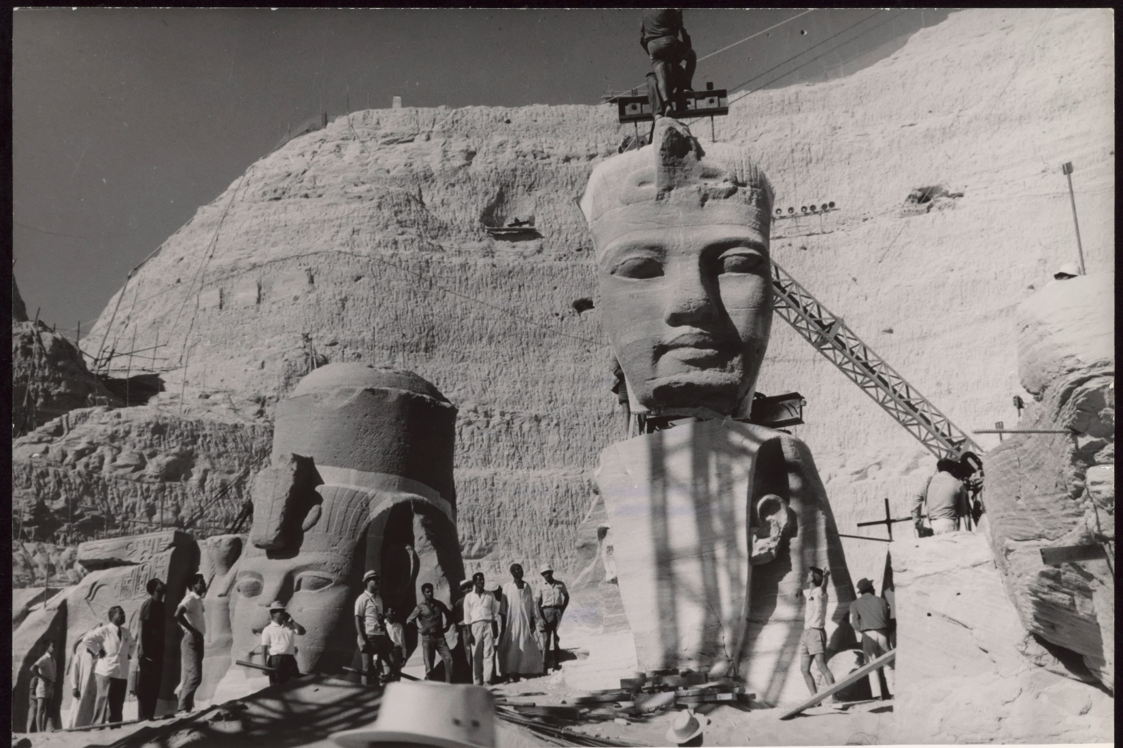
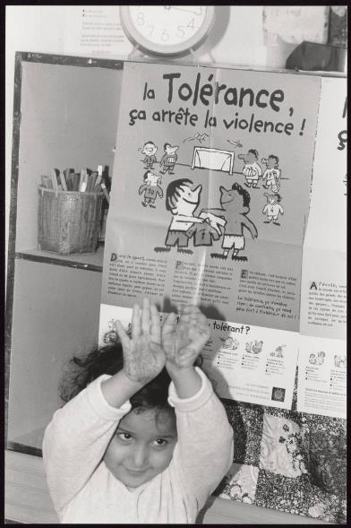
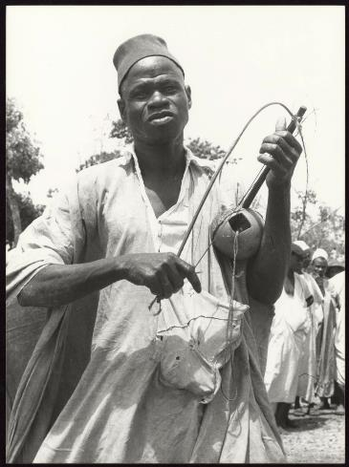
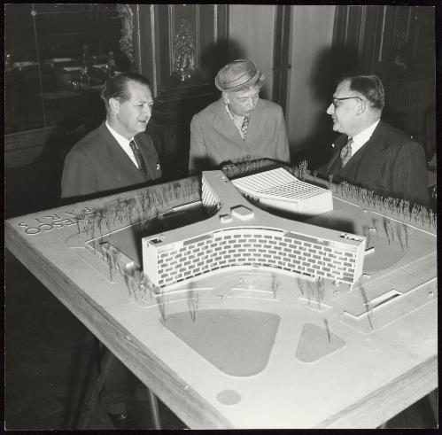

Slide 26
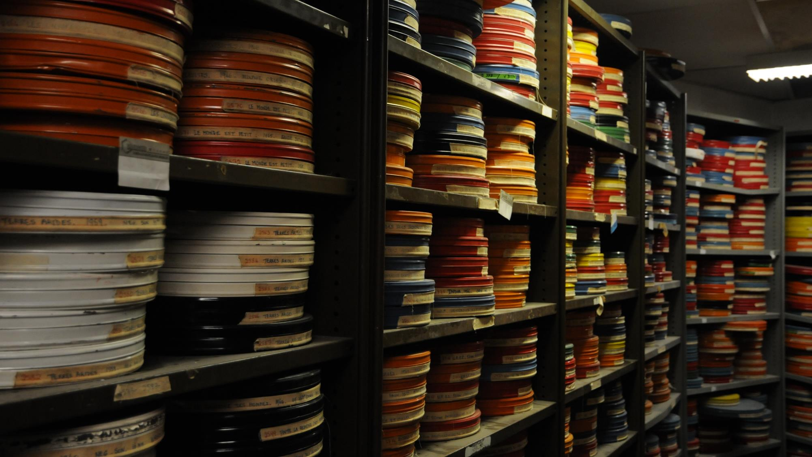
collections
films

Slide 27
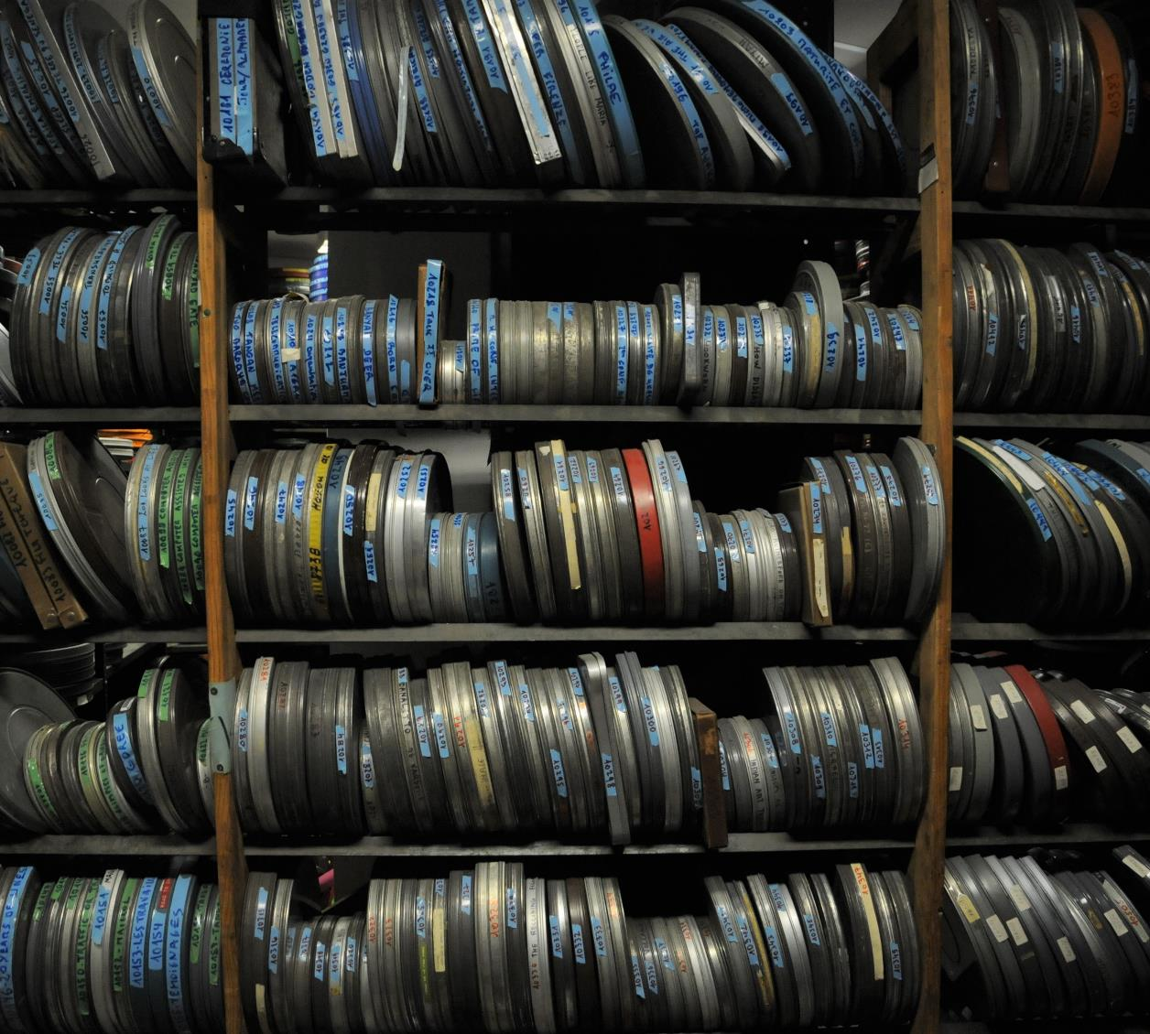
films
Volume:
108 16mm films (≈45 hours)
Tech. specs:
Content Type: Visual: Film, 16mm Master: Apple QuickTime/Compression : Apple ProRes 422 HQ (.mov) Access: Mpeg4 (H264 at 4000kb/s (max.) ACC audio at 192 bitrate, sample rate 48000Hz Resolution: HD (1920x1080)

Slide 28
films
About: Films produced and co-produced by UNESCO, and films about UNESCO, cover a wide range of its activities and include such titles as That All May Learn (1949), You and Human Rights (1950), The Treasures of Nubia (1960) and The Sun of the Earth (1971).
Challenges: Inherited collection.
Unreliable Access database; disorganized storage
“It took me two days to find what I was looking for…”
Multiple elements; Condition assessment
Conservation: All films cleaned by hand. Reels and boxes changes. Only minor corrections (e.g., colour); no restoration.
Remaining: ≈2,000 16mm and 35mm films

Slide 29
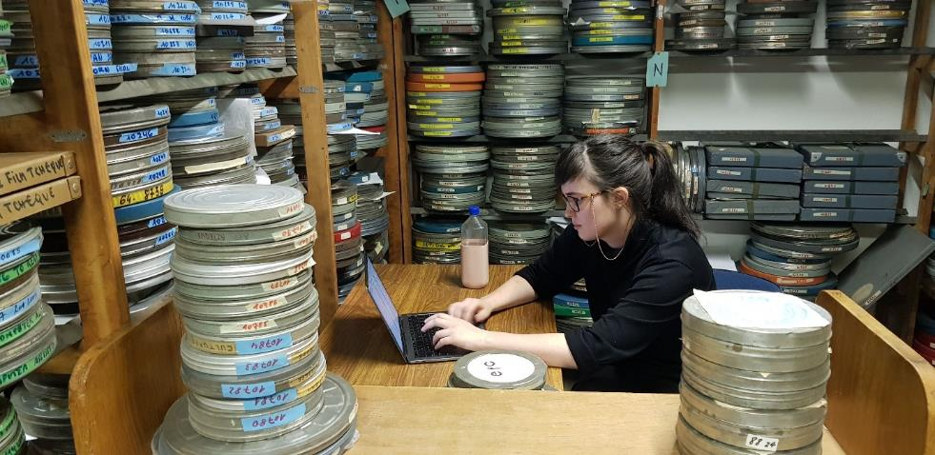
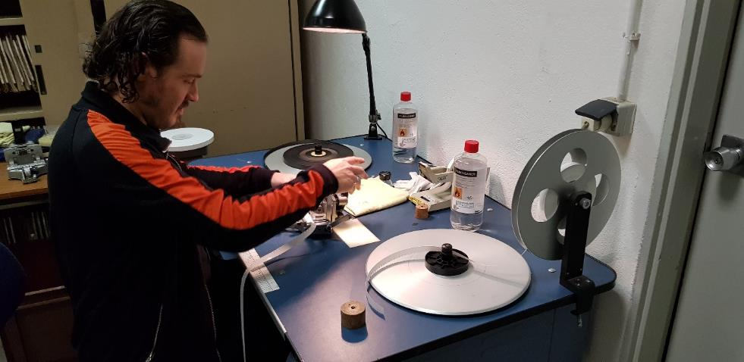
films

Slide 30
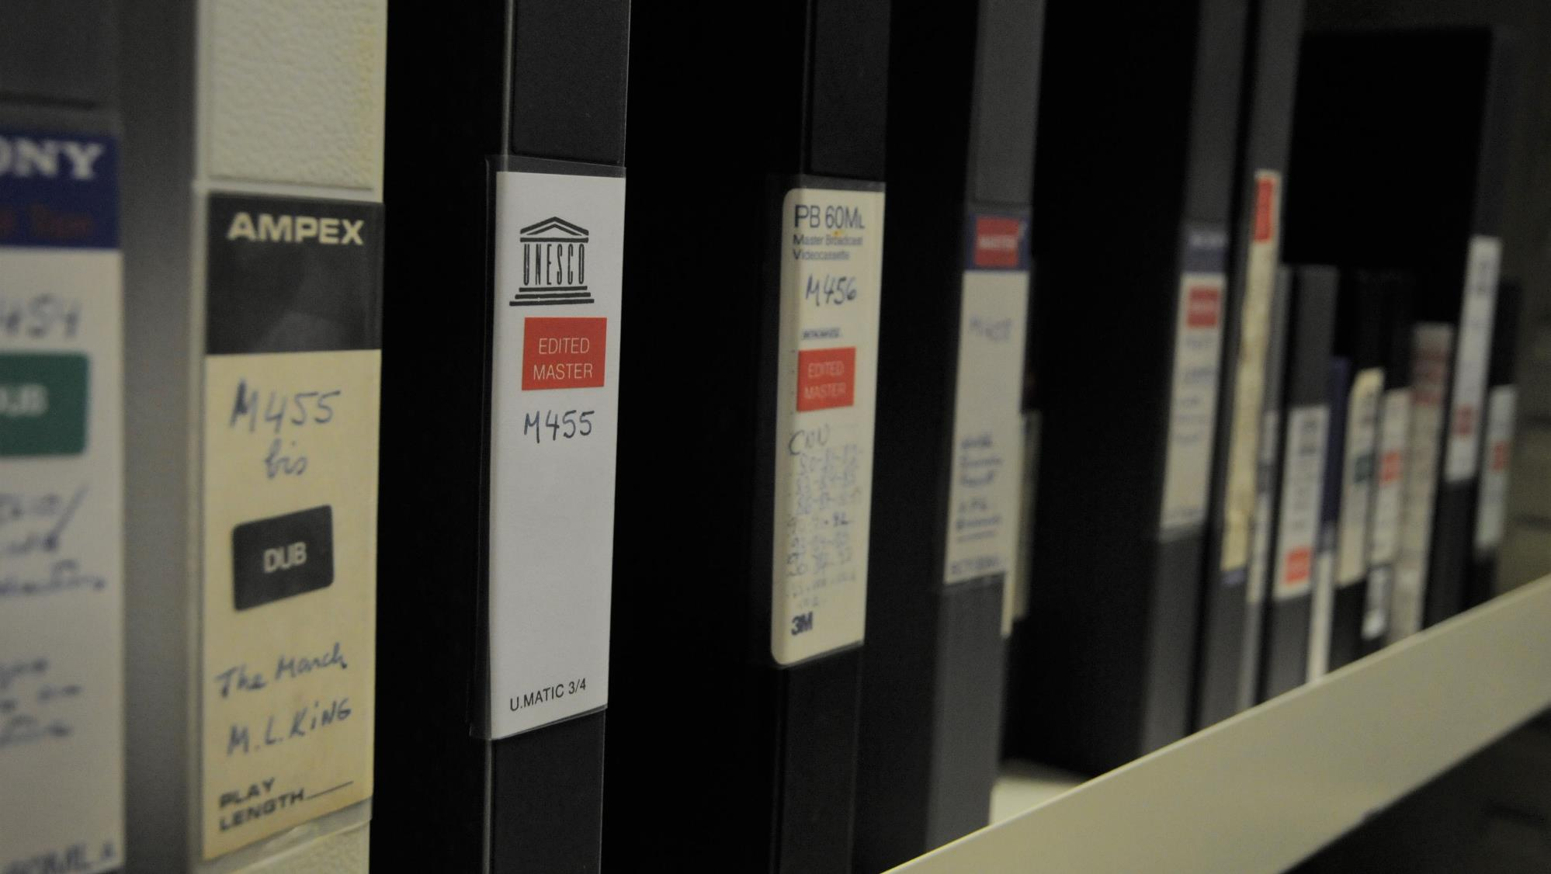
collections
videos

Slide 31
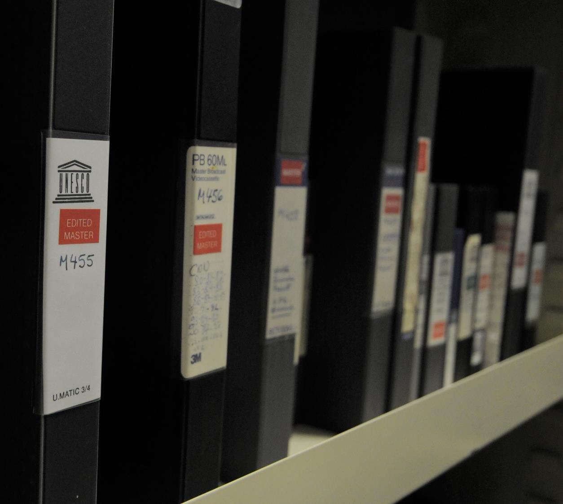
videos
Volume:
98 Umatic videos (≈35 hours)
Tech. specs:
Visual: Video, Umatic Master: Apple QuickTime/Compression : Apple ProRes 422 HQ (.mov) Access: Mpeg4 (H264 at 4000kb/s (max.) ACC audio at 192 bitrate, sample rate 48000Hz Resolution: SD (maintain 4:3 aspect ratio)

Slide 32
videos
About: UNESCO TV programmes from the 1980s. Titles include Violins of Peace (w/ Yehudi Menuhin), Only One Earth, People of the Desert, and UNESCO World Public News.
Challenges: Inherited collection.
Unreliable inventory
Umatic is TV quality to begin with
Encoding differences NTSC, PAL, SECAM
Requires original machines to digitize
Baked in laboratory oven from 24hrs to 2 weeks
Conservation: No. Re-digitization not possible.
Remaining: All programs only on Umatic carrier digitized.

Slide 33
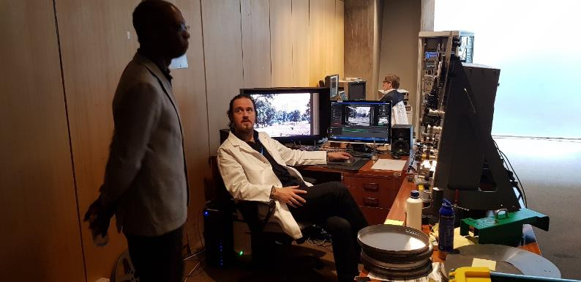
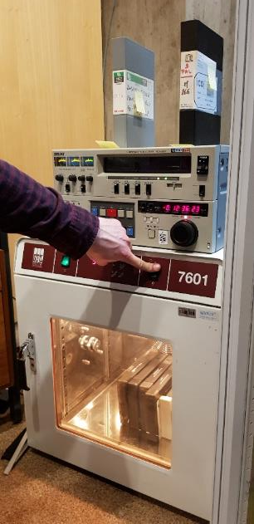
videos

Slide 34
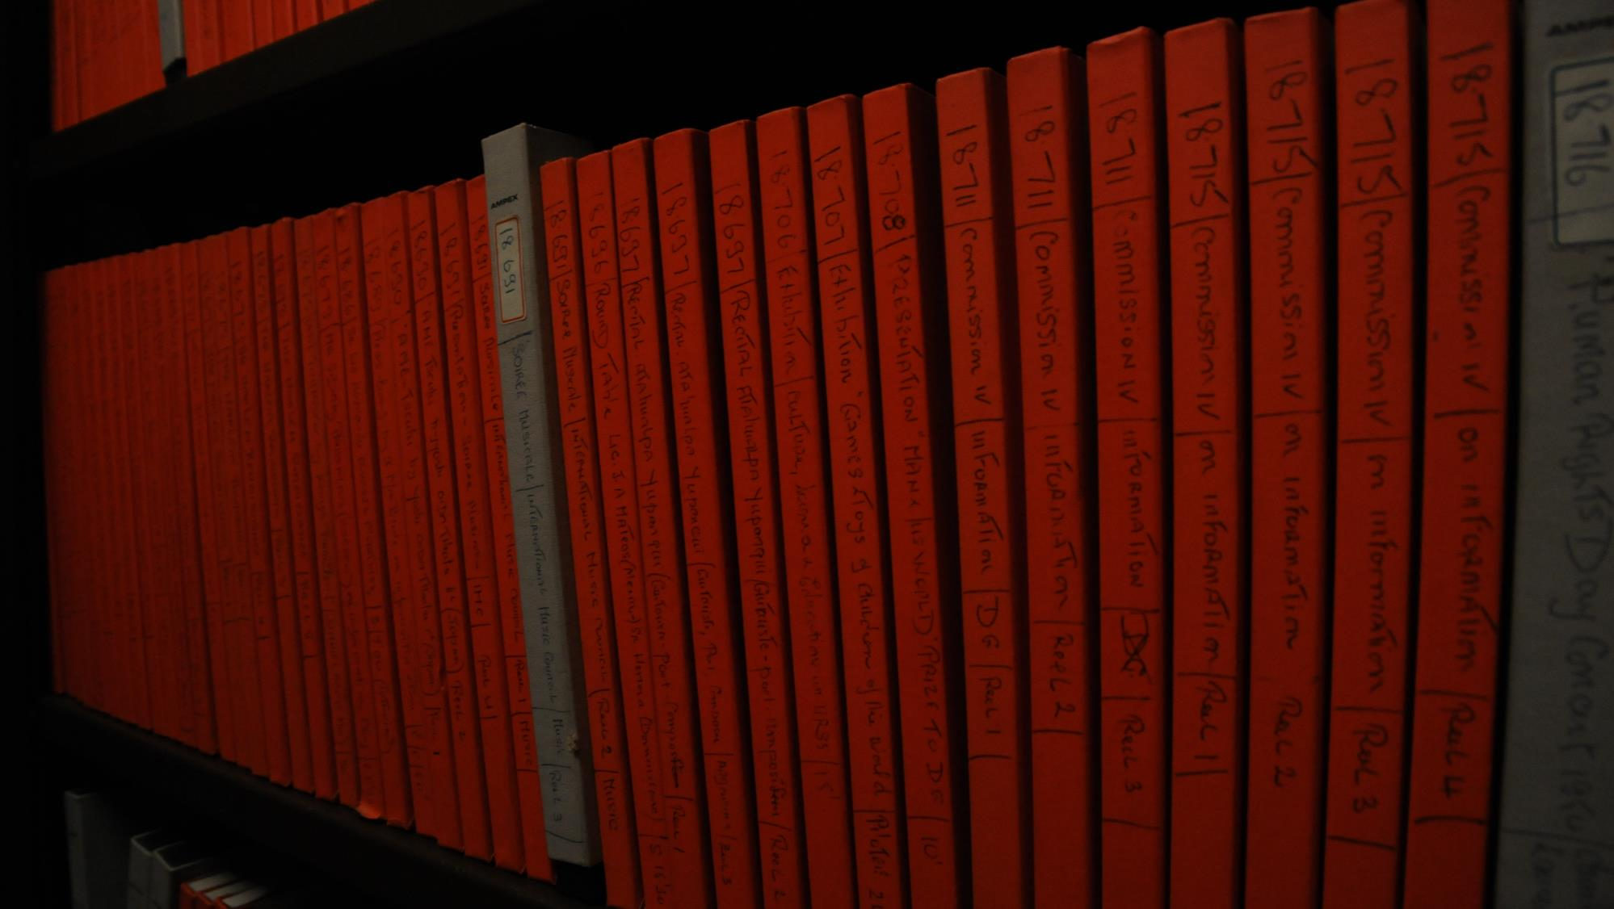
collections
sound

Slide 35
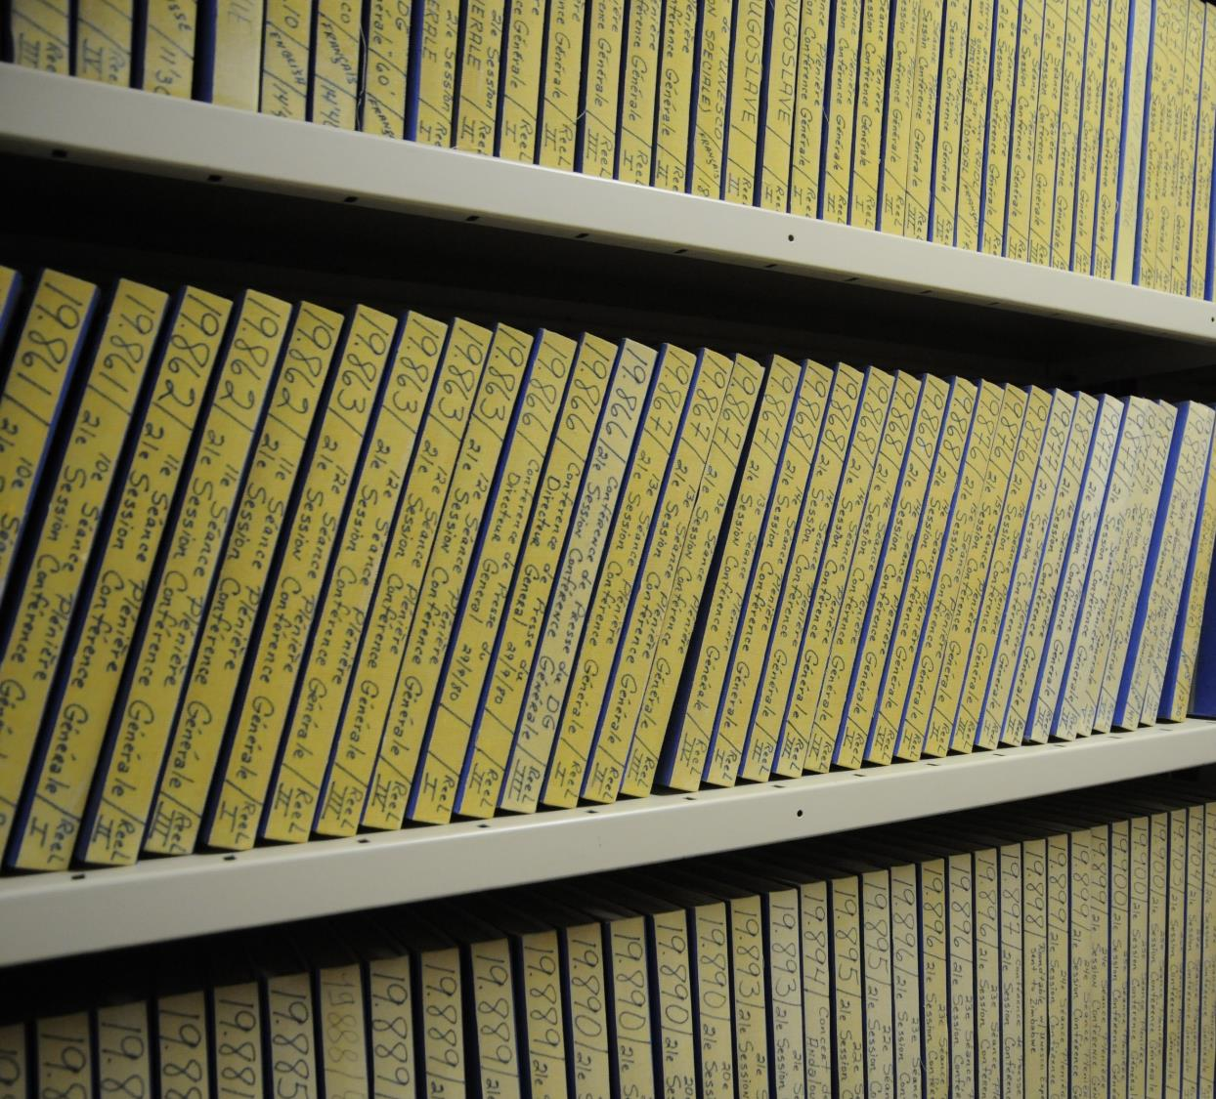
sound
Volume:
17,901 magnetic tape reels (≈7,000 hours)
Tech. specs:
Audio: 1/4" magnetic tapes Master: .wav Access: .mp3 Resolution: 48 kHz / 24 bit Compression: Uncompressed (PCM) (more detail on request)

Slide 36
sound
About: Recordings include radio reports, specially-produced programmes, interviews and other recordings from the late 1940s to 1980s. Agfa, Audio Devices, and Ampex brand tapes.
Challenges: Inherited collection.
Inventorying, barcoding and shipping 17,901 reels
Paper-based catalogue of only 2,000 recordings
15% require addition of leader tape
600 Ampex require additional baking treatment
Conservation: Tape cleaning/dusting. Replace damaged boxes. Plan to digitize and index 60,000 index cards.
Remaining: 1000s of hours of raw mission recordings. 1000s of hours of Sound Unit conference recordings (multiple brands of magnetic tape; plus DAT tapes, etc.). UNESCO discs in NY.

Slide 37
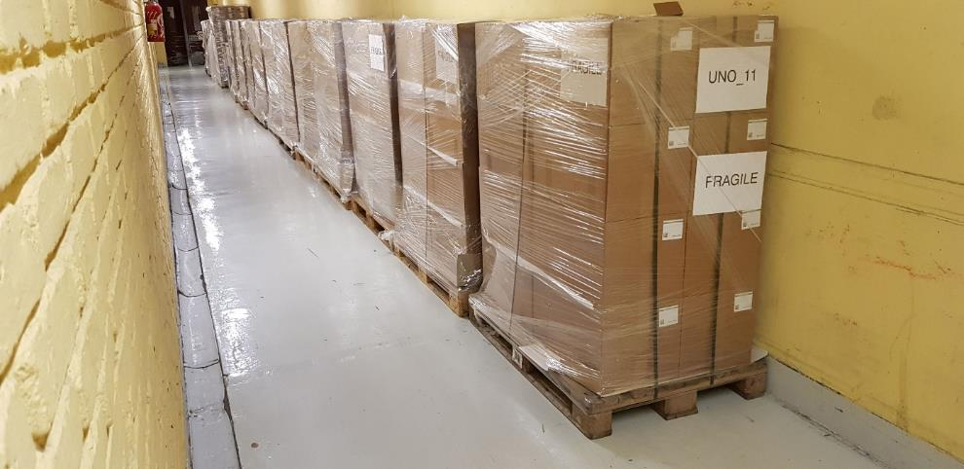
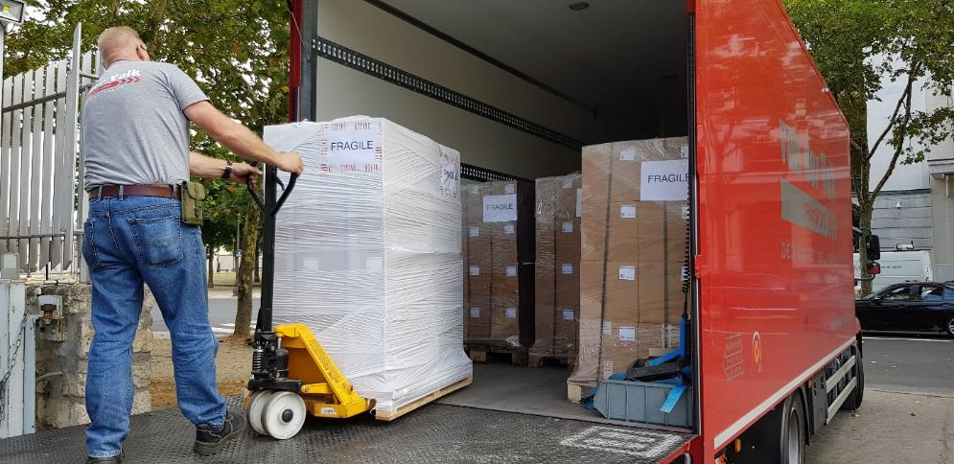
sound

Slide 38
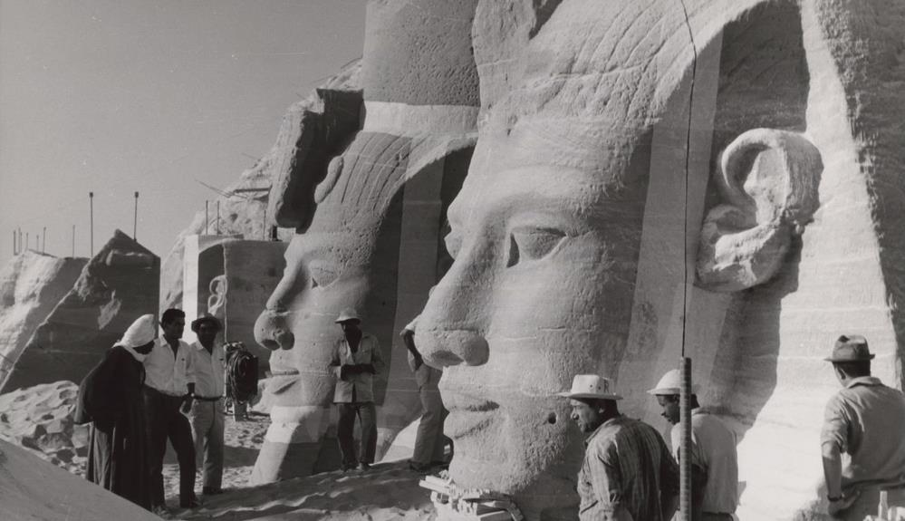
crowdsourcing
transcription and enrichment

Slide 39
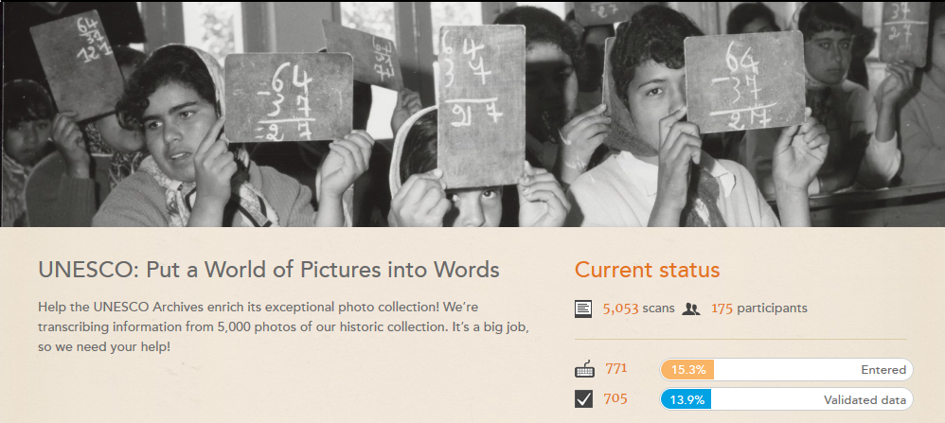
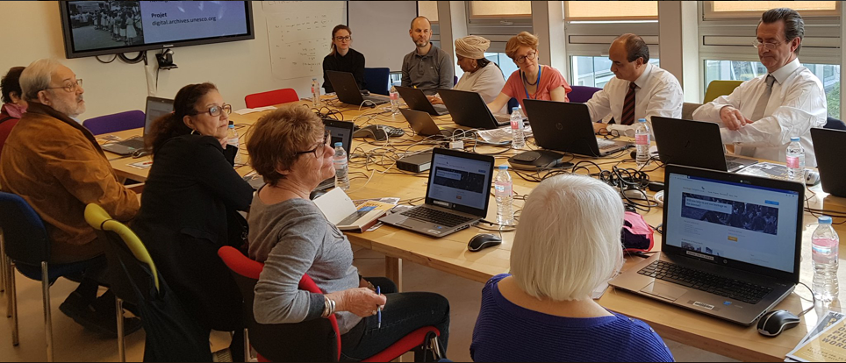
crowdsourcing
Join us!
heritagehelpers.co.uk

Slide 40
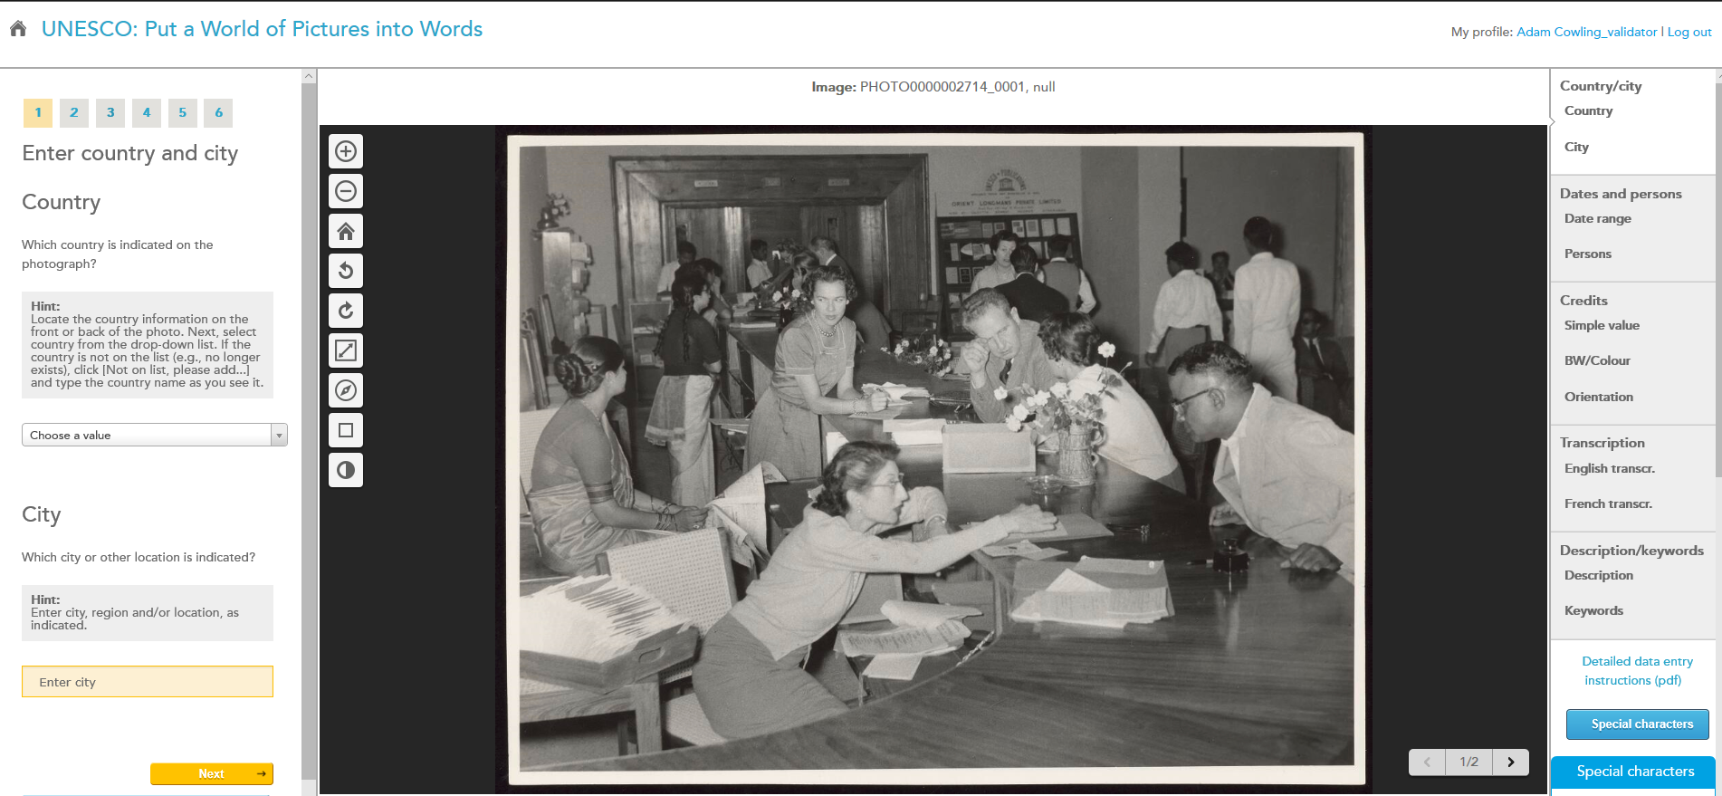

Slide 41
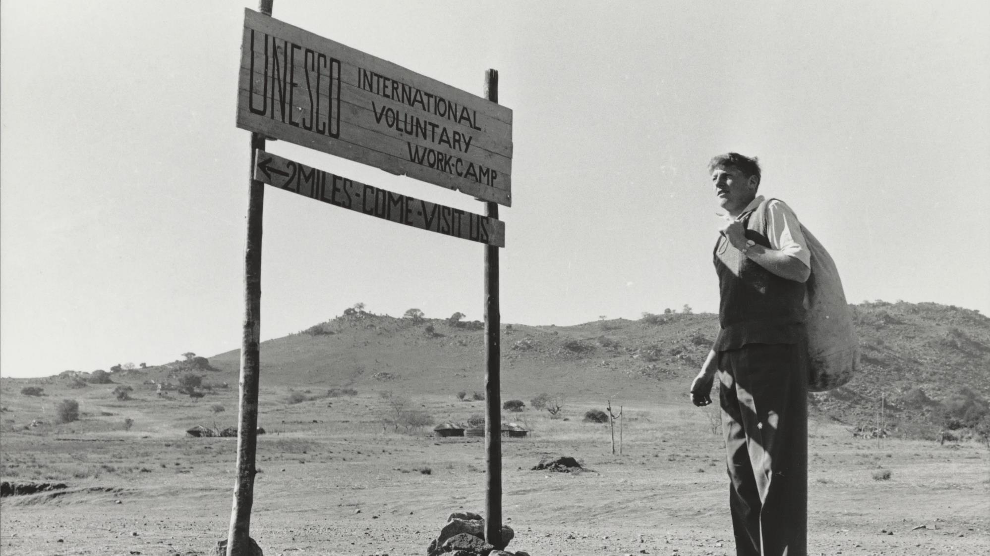
visibility
contributing to UNESCO’s (Archives’) visibility online and throughout the world

Slide 42
visibility
blog
pick of the week
web exhibitions

Slide 43
visibility
Over the last year and a half, the UNESCO Archives has welcomed many visitors to the digitization lab, including:
Project sponsor
UNESCO Delegations
UNESCO National Commissions
UN and UN-family organizations
Local and international archives and AV institutions
Universities, researchers and historians
UNESCO staff from HQ and Field Offices
Private sector
Members of the general public
visits

Slide 44
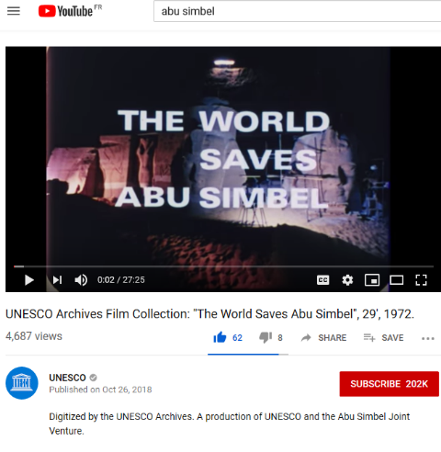
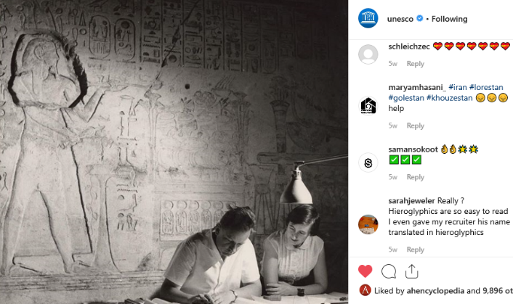
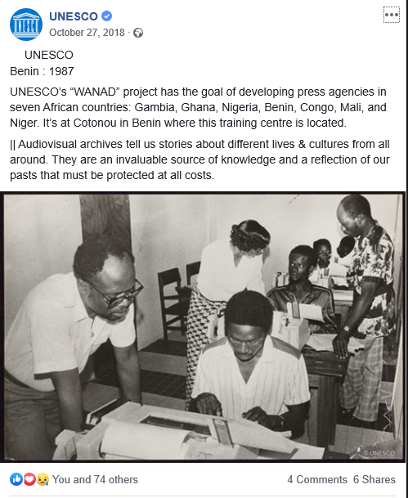
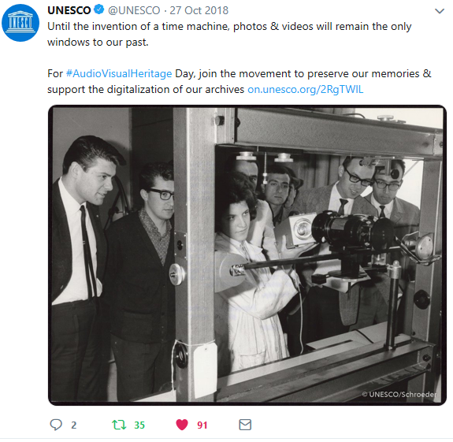
visibility
social media

Slide 45
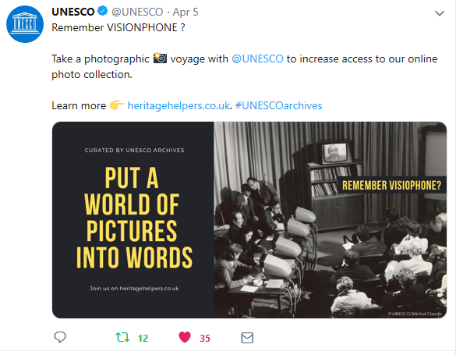
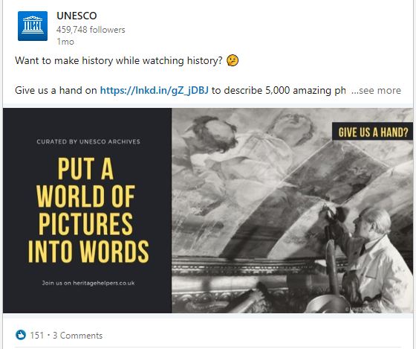
visibility
social media

Slide 46
visibility
internal communication

Slide 47
visibility
Transforming lives through education Digitized photographs from the UNESCO Archives are used throughout this publication. (2018)
Long Walk of Peace : Towards a Culture of Prevention A digitized photograph from the UNESCO Archives is used on the cover of this publication. (2018)
World Heritage Review Six digitized photographs are used in this issue, including the cover photograph. The photographs help illustrate the article on page 22, entitled "Abu Simbel: The Story of an Extraordinary Rescue". (Jan. 2019)
publications

Slide 48
visibility
publications
Upcoming UNESCO Archives co-publication on David Seymour album
This will be UNESCO Archives first co-publication. During the project’s preparatory phase, an album of 78 pages of contact sheets and accompanying text was discovered. The album was created by world-renowned photographer David Seymour as part of a reportage commissioned by UNESCO on the campaign against illiteracy in Calabria, Italy, in 1950

Slide 49
visibility
Roundtable on "Building Just and Peaceful Societies: UNESCO's contribution to a Culture of Prevention" Paris, September 2018 A slide show of digitized photographs from the UNESCO Archives was presented during this roundtable at UNESCO Headquarters.
FIAT/IFTA World Conference 2018 Venice, October 2018 A slide show of digitized photographs from the UNESCO Archives was presented during the event's keynote speech by the Director of the UNESCO Regional Bureau for Science and Culture in Europe.
INA FRAME - UNESCO UNESCO Archives will host a one-day workshop (upcoming - 20 June 2019)
IFLA 2019 - 85th General Conference and Assembly Paper (upcoming - August 2019)
IASA 2019 - 50th Annual Conference Paper (upcoming - September 2019)
events

Slide 50
visibility
Participated in the UNESCO Heritage Lab at the Journées Européennes du Patrimoine (JEP) on 15-16 September 2018.
events

Slide 51
visibility
events

Slide 52
visibility
Les nuits de France Culture 13 février 2019
For World Radio Day 2019, UNESCO Archives teamed up with France Culture to propose 6 programmes, drawing from the digitized audio recordings.
radio

Slide 53
visibility
Picasso et la Guerre at the Musée de l’Armée Paris, April to July 2019 UNESCO Archives loaned archives and photographic material to the exhibition display on the painting ‘The Fall of Icarus’.
Photo contact sheets discovered during survey of the photograph collection during the project’s preparatory phase.
exhibitions

Slide 54
visibility
The UNESCO Director-General, Audrey Azoulay, has requested a series of framed photographs to decorate her waiting room on the 6th floor.
exhibitions (internal)

Slide 55
visibility
oral histories

Slide 56
visibility
Partnership agreements signed with:
Agreements under development with:
partnerships

Slide 57
next
Migration to new UNESCO DAM and access platform
Have relied on vendor DAM and promotional website
UNESCO ‘Digital Library’ not ready for digital AV assets yet
Challenge of multiple assets and data sets; AtoM integration
Data storage
Invested in 100TB of dual site replicated NAS storage
Long-term reliability concerns
Should we consider 3rd level Azure storage?
No digital preservation so far
Funding
Many expressions of interest, still waiting for $/€
Just getting started; so much more to do…
challenges

Slide 58
next
External Project Evaluation
RFQ just issued – evaluation team selection by end-May
Have formed a Reference Group of 6 representatives of different Sectors and Services at UNESCO to monitor the evaluation
Final Report due end-October 2019
Project wrap-up
Steering Committee and Donor reports
Budget considerations
Continue communication and visibility work
Integration of crowdsourcing transcription data
Digital preservation – planning to hire digital archivist
‘Deeper’, automated indexing and structuring of project data
and more…
looking forward

Slide 59
end
presentation by
adam cowling
photo credit
christelle alix
maëva nguyen

